Slide 1
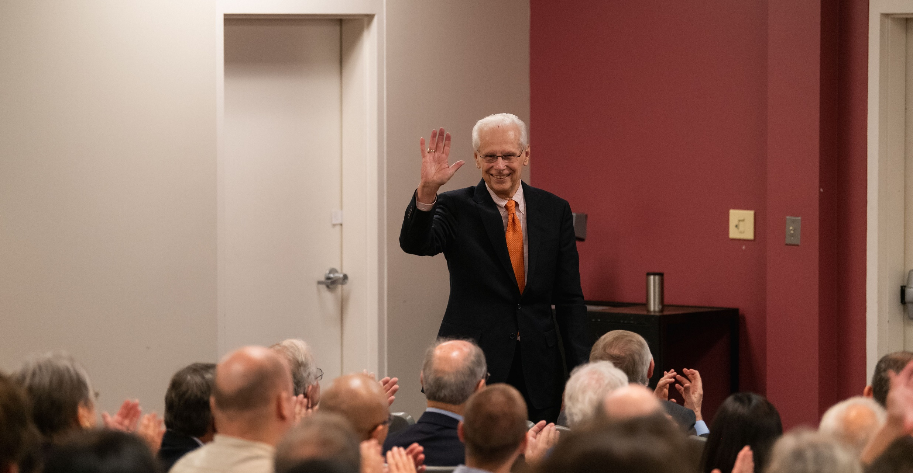
Tom Keinath is introduced at the seminar held in his honor.

Slide 2
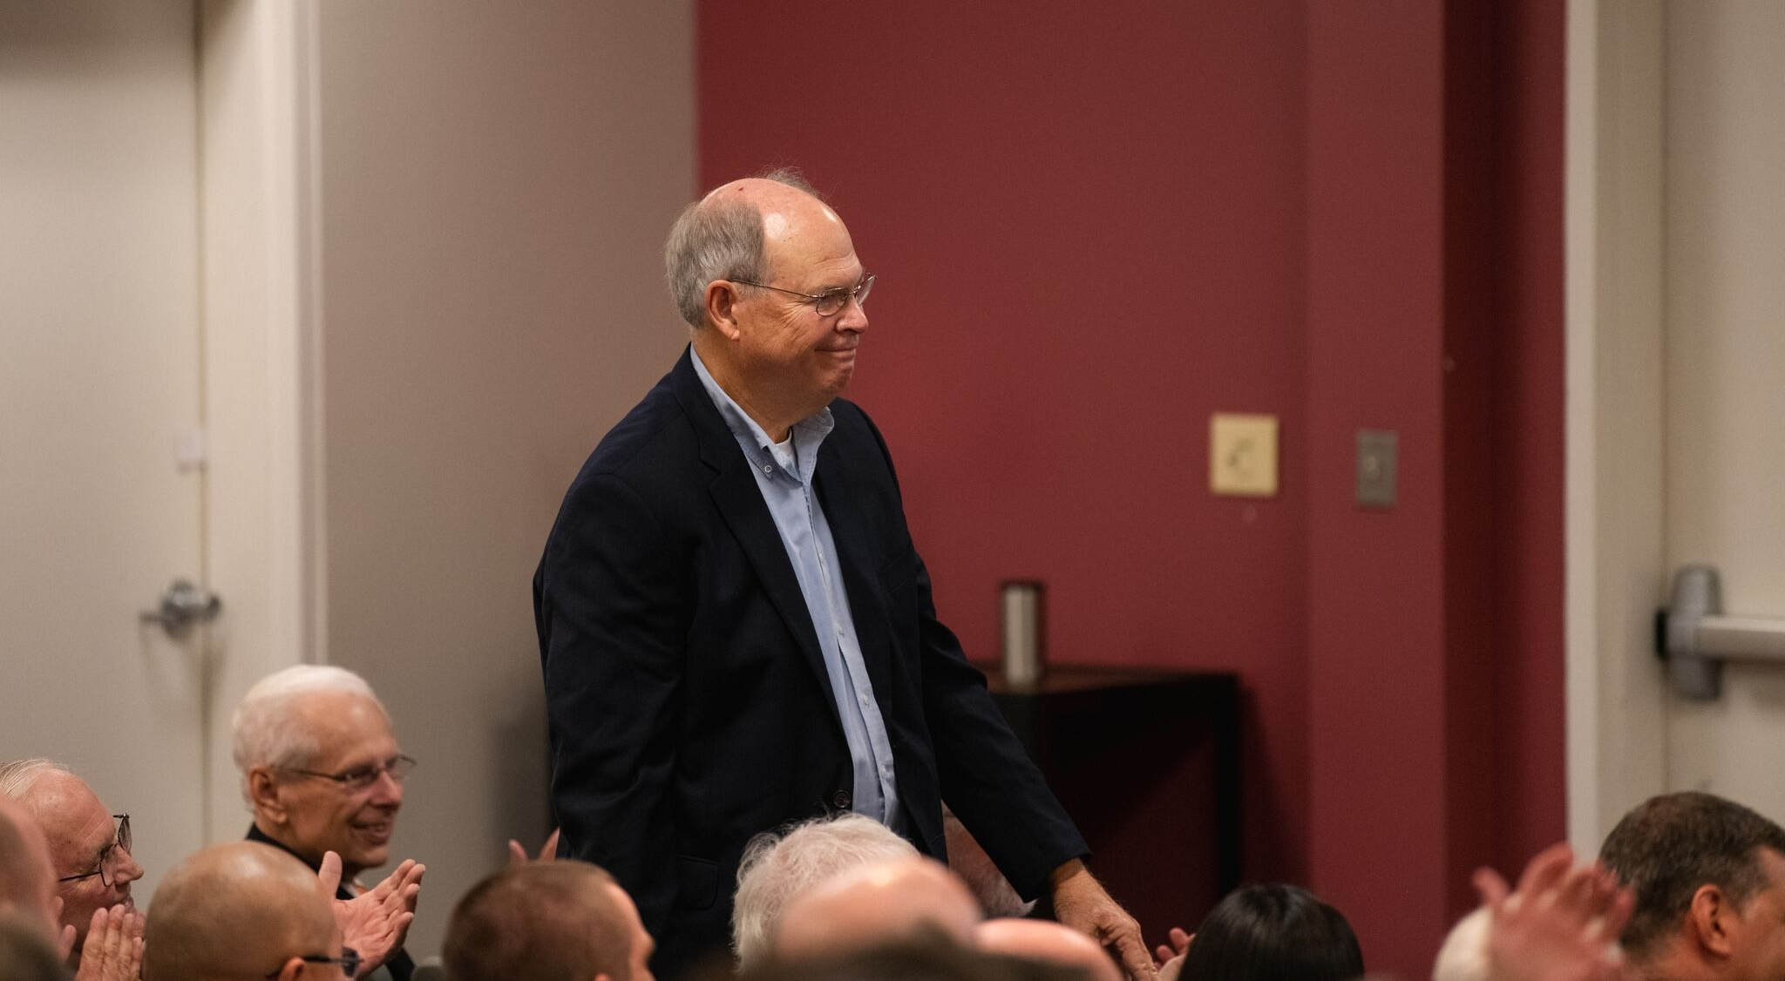
Alan Elzerman, Emeritus faculty member and former Chair of the Department

Slide 3
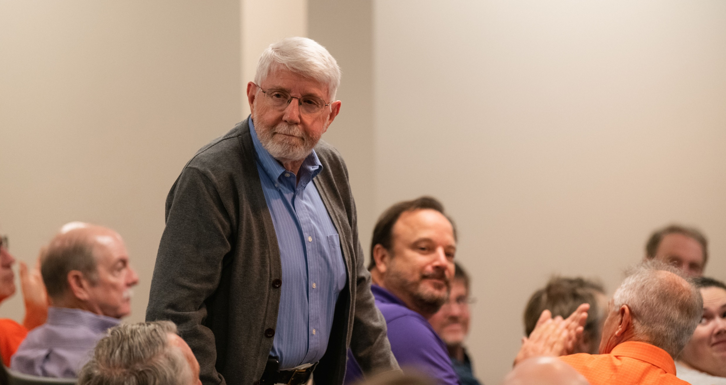
C. P. Leslie Grady, Jr., R. A. Bowen Professor Emeritus

Slide 4
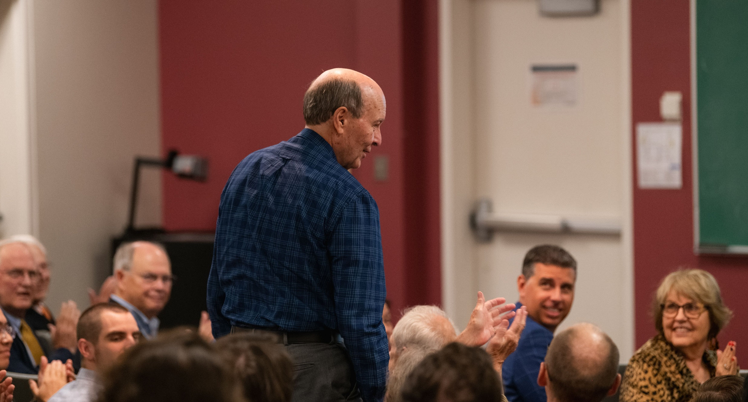
Fred Molz, Research Professor & Distinguished Scientist Emeritus

Slide 5
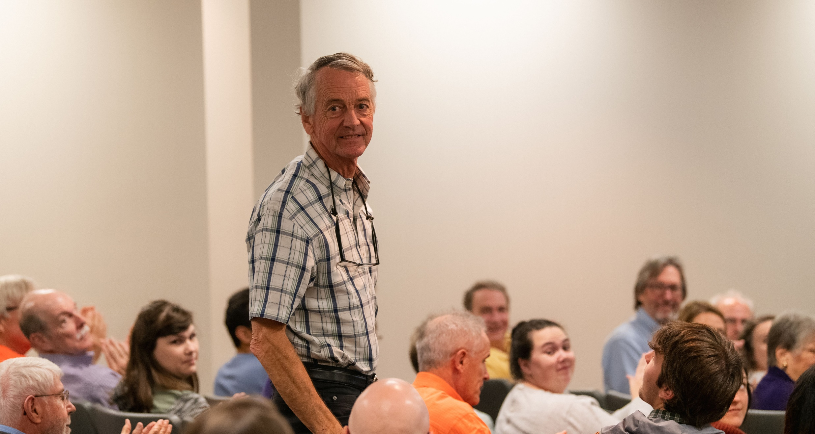
Robert A. Fjeld, Emeritus Professor & Dempsey Chair of Environmental Engineering

Slide 6
David L. Freedman, Professor and Chair of EEES, welcoming the visitors and introducing the seminar speaker.

Slide 7
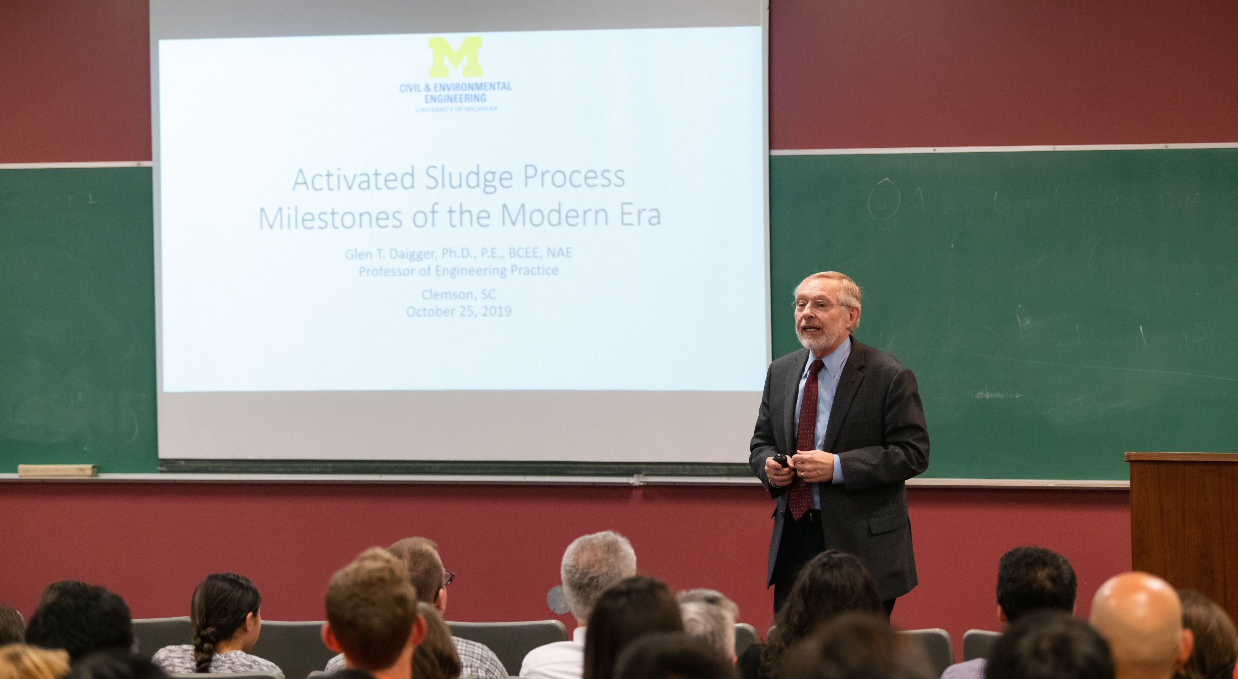
Glen T. Daigger, Professor of Engineering Practice at the University of Michigan and seminar speaker

Slide 8
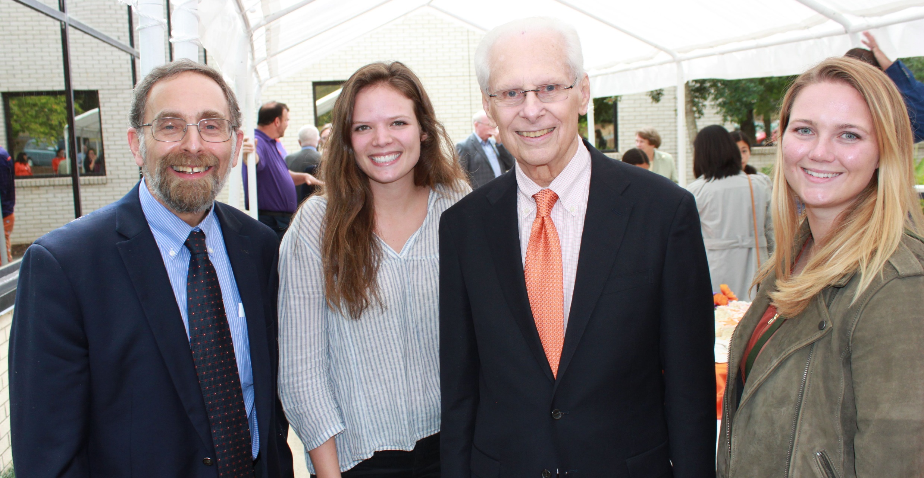
Left to right: David Freedman, Allison McLane, Tom Keinath, and Sarah Donaher. Allison and Sarah received the Keinath Award for outstanding undergraduate students majoring in Environmental Engineering.

Slide 9
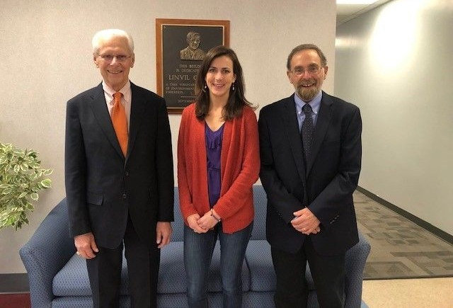
Left to right: Tom Keinath, Katie Van Valkinburgh, and David Freedman. Katie received the Keinath Award for outstanding undergraduate majoring in Environmental Engineering. She is currently working on her MS degree. A plaque honoring Gene Rich is in the background.

Slide 10
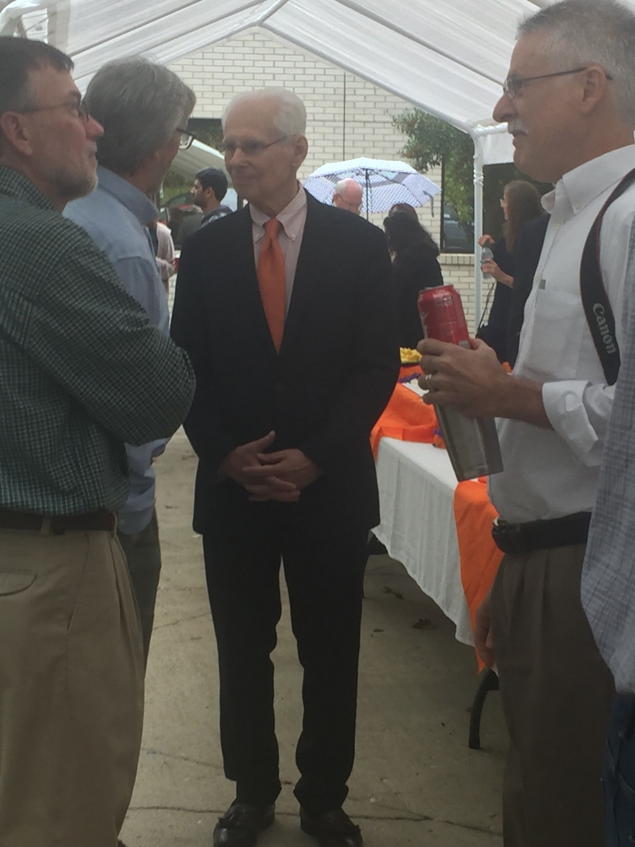
Tom Keinath speaking with a former student at the reception held after the seminar. Professor Tim DeVol is in the foreground at the right.

Slide 11
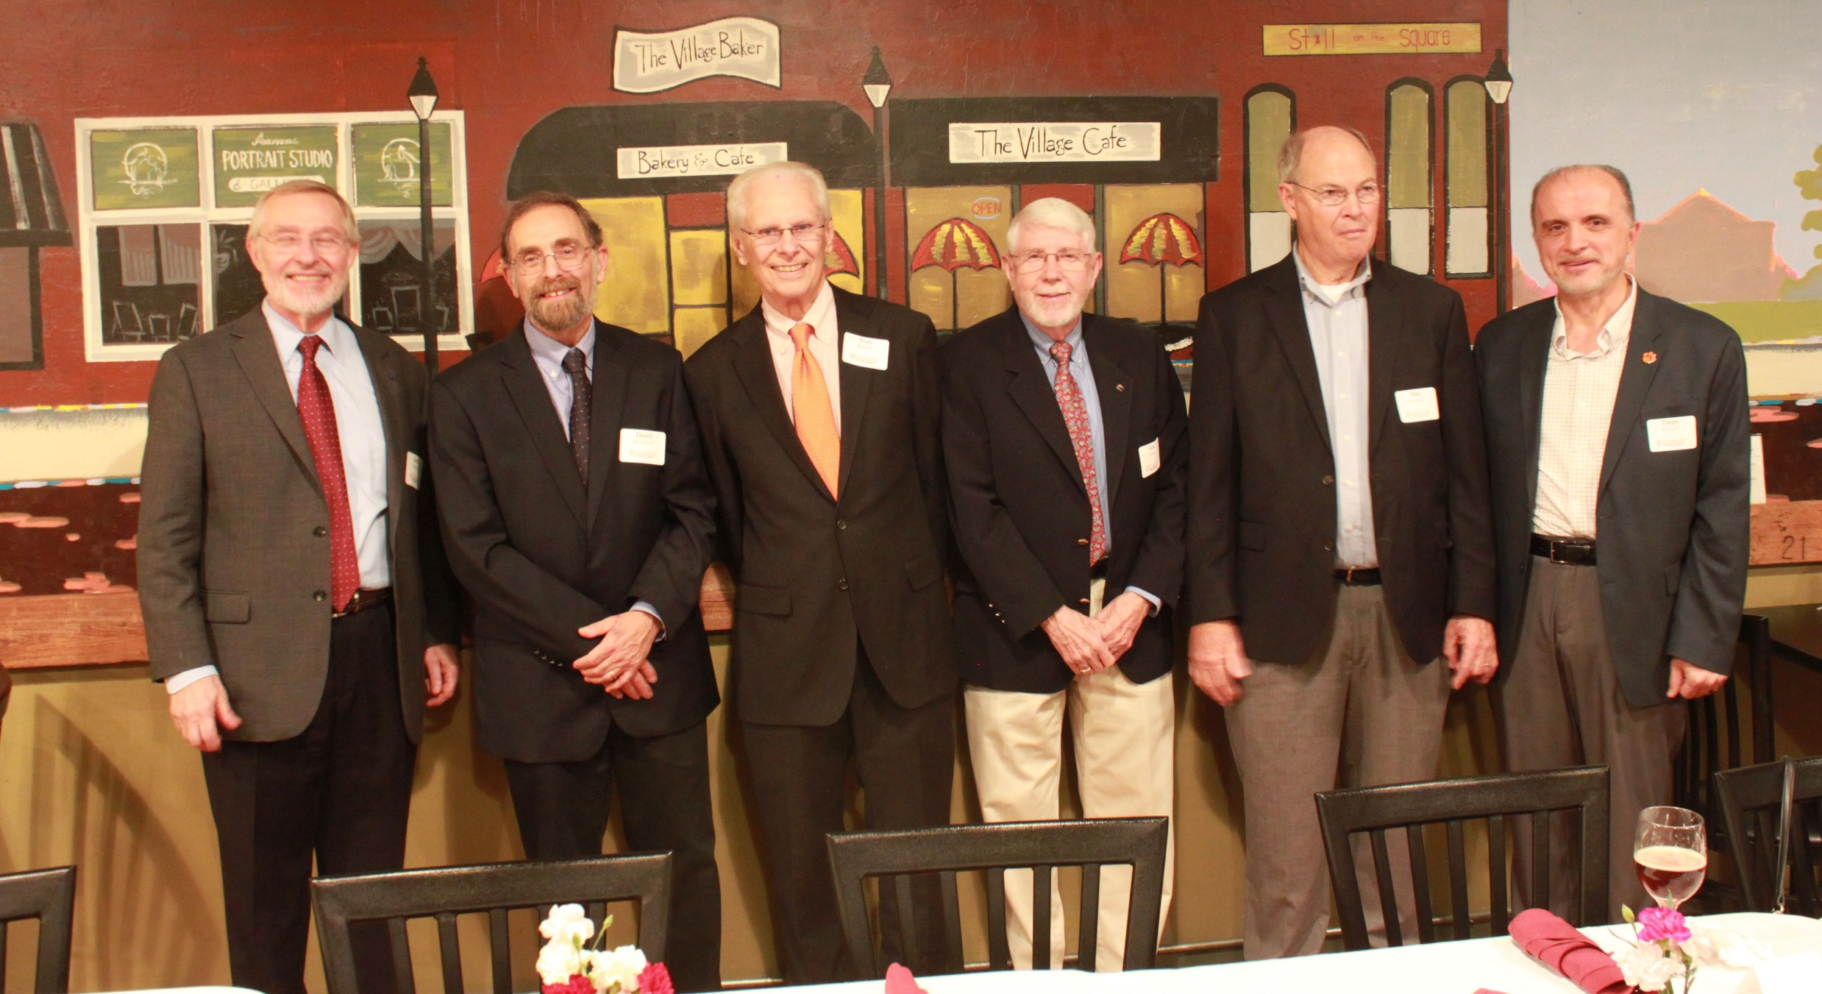
Left to right: Glen Daigger, David Freedman, Tom Keinath, Les Grady, Alan Elzerman, and Tanju Karanfil, at a dinner held in honor of Tom and his family.

Slide 12
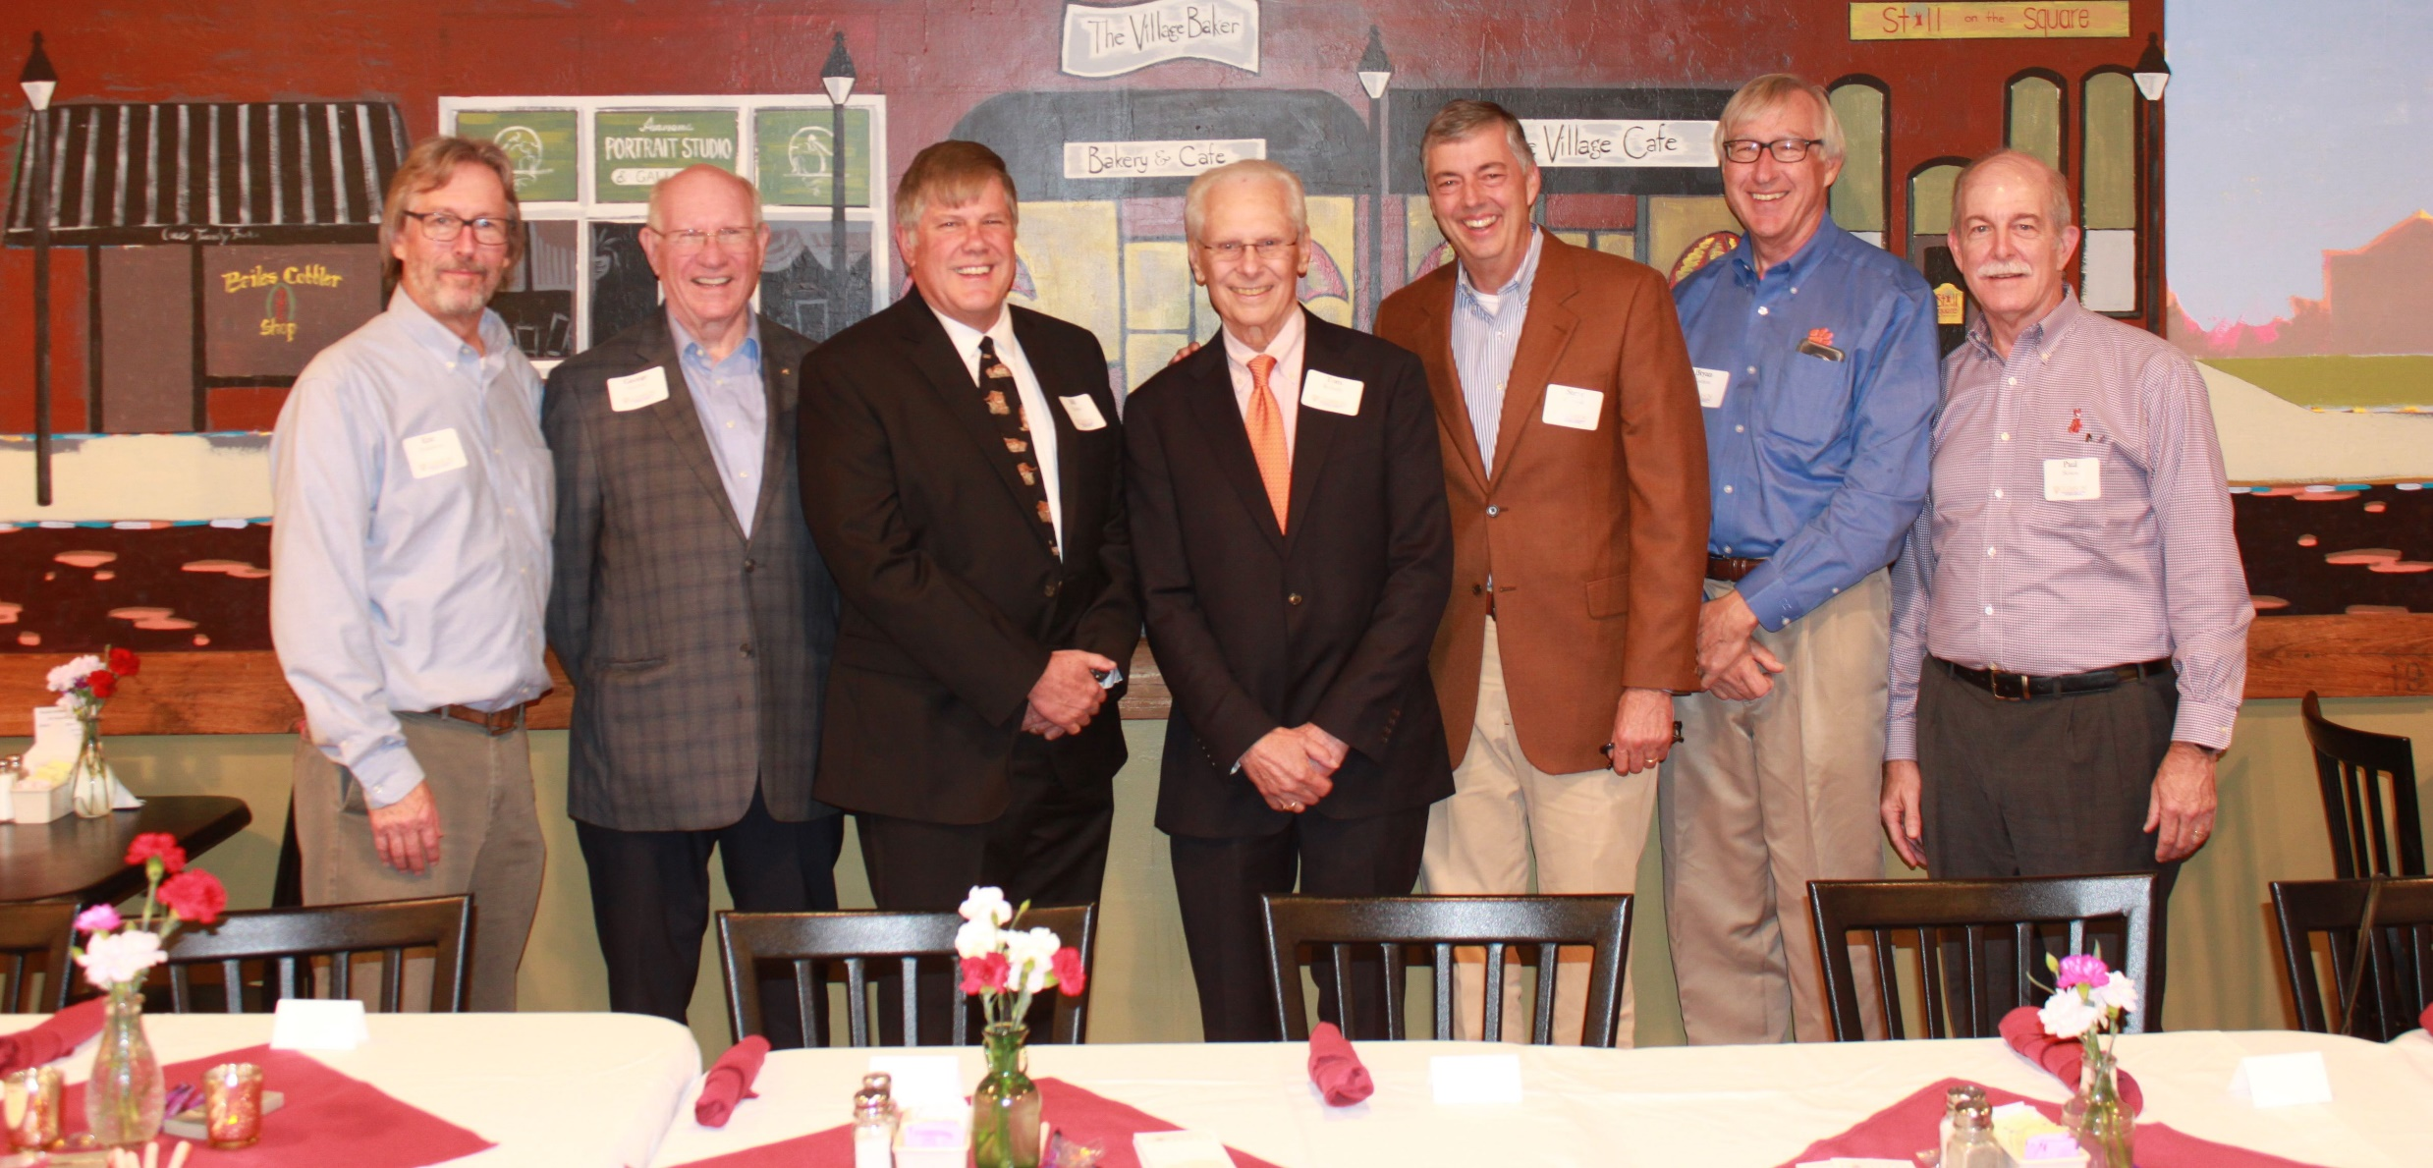
Left to right: Eric Wahlberg, George Fletcher, Bill Heatley, Tom Keinath, Steve Cawood, Bryan Cashion, and Paul Bowen, at a dinner held in honor of Tom and his family.

Slide 13
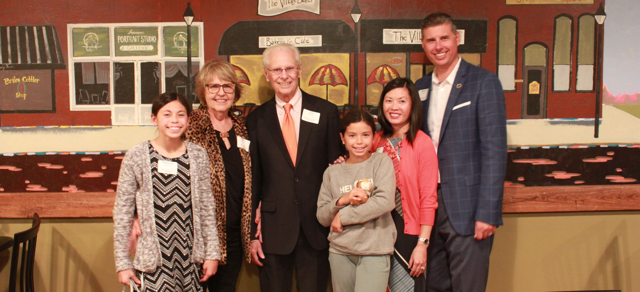
The Keinath family at dinner. Left to right: Mckenna , Karen, Tom, Sydney, Jennifer Chin, and Michael.

